Slide 1
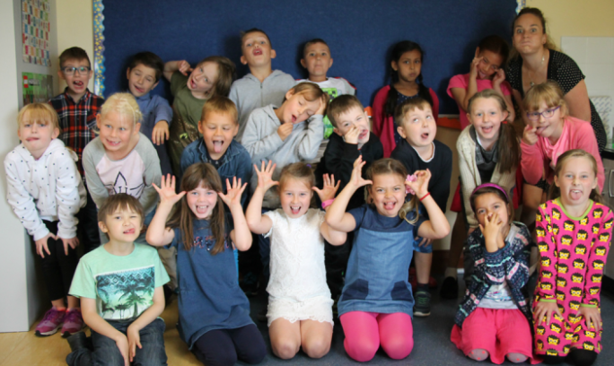
Welcome to Second Class!

Slide 2
Some information...
Spiral Curriculum – revisiting same topics each year – building on what we know, extending out learning
P.E. Day: Wednesday for the moment – may change in the coming months.
Lunches – please ensure that whatever your child brings for lunch can be packed back in their schoolbags afterwards (i.e. resealable drinks containers, etc.)

Slide 3
Classroom Management
Class Expectations
The Ladder
Red Card
Yellow Card
Time Out
Warning

Slide 4
Learning at Home
Reading, spellings, tables are my priorities as these are the things that require one-to-one attention – I need your support with this
Homework as a communication tool – reason for written work
Parent-led learning in the home
Class website – source of information for parents – keep up with what we’re doing
Children welcome to share learning from home

Slide 5
Seesaw
Assessment/ communication tool I am trialling this year.
You will only be able to see your own child’s work.
Helps me to celebrate your child’s good work
Allows me to draw your attention to things we need to work on
You should have received an invitation to join the app in your child’s homework

Slide 6
Thank you for listening
www.curriculumonline.ie

